Slide 1
Tableau to Snowflake
AI-Powered Analytics Platform Modernization Accelerator
[ Tableau → Streamlit in Snowflake ]
Streamlit in Snowflake | Cortex AI | Cortex Analyst | Native Semantic Views | Snowpark
Notes:
One-line framing: this modernizes the analytics stack in place — the customer's existing Tableau dashboards, rebuilt natively on the platform that already holds the data. The product strip at the bottom is the only place the full stack is listed; the rest of the deck stays light.

Slide 2
Why This Accelerator
Modernize the analytics stack — the same dashboards, running natively on the data Snowflake already holds
THE CHALLENGE
THE ACCELERATOR SOLUTION
Licences on Top of Snowflake
Dashboards Move to What You Own
Paying a second platform to display data Snowflake already holds
Streamlit is already part of Snowflake — no BI licence underneath
A Separate, Scarce Skill
Your Data Team Owns It
Every dashboard waits on Tableau specialists
Streamlit is Python — built by the engineers already on the platform
Two Platforms, Two Governance Models
One Platform, One Set of Roles
Access rules rebuilt away from the data they protect
Governance inherited from Snowflake, not re-implemented
Modernisation here removes a layer instead of adding one — the barrier was only ever the cost of rebuilding the dashboards by hand, and that is what the accelerator automates.
Notes:
Kept to one line per cell, per the feedback. The subtitle is the modernization framing: the stack is modernized in place — same dashboards, native on the platform that already holds the data. If asked what changes for end users: the dashboards look and answer the same; what disappears is the licence, the specialist queue, and the second governance model.

Slide 3
How It Works
Five automated stages inside the customer's Snowflake account — with a human gate before anything ships
01
02
03
04
05
Discovery
Parsing
Cortex Translation
Semantic + App
Validation
Finds every datasource and loads the data into Snowflake
Reads charts, calculations, filters and layout from the workbook
Cortex AI converts the complex calculations into Snowflake SQL
Deploys a native semantic view and generates the Streamlit app
Ties every measure back to the source, with evidence
Human in the loop — every Cortex proposal is executed against the real data, then reviewed and approved before it ships. All decisions audited.
90%+
Minutes
Every measure
5
CONVERTED AUTOMATICALLY
PER WORKBOOK, NOT SPRINTS
VALIDATED WITH EVIDENCE
AUTOMATED STAGES
Lower delivery cost — dashboards no longer wait on dedicated rebuild time. Minimal AI cost — Cortex runs only on the calculations the rules cannot translate.
Notes:
Stats live here now, merged from the old Impact slide, matching the reference deck's pattern. All four are defensible: 90%+ is the design target the corpus exceeds, minutes-per-workbook is the real hosted-app runtime, and every-measure validation is the Stage 5 parity check. The human gate line is deliberately one sentence — an enterprise control, not a caveat.

Slide 4
Built Natively on Snowflake
The pipeline runs inside the customer's account, powered by Snowflake Cortex AI
1
2
3
Runs entirely in the account
Powered by Cortex AI
A semantic model falls out
Every stage executes on Snowflake compute; no data leaves the environment.
In-account Cortex models translate the hard calculations and validate the result.
Each workbook's verified measures become a native semantic view, ready for Cortex Analyst.
4
5
6
Governance stays in force
No data movement
You own the result
The app runs as a Snowflake role — existing policies and security apply unchanged.
Dashboards read Snowflake tables directly — no extract, no copy, no staleness.
Generated apps, views and evidence live in the customer's account, maintainable by their team.
Every migrated dashboard converts a Tableau extract into live Snowflake consumption — warehouse compute on every view, Cortex on every migration.
Notes:
This slide absorbs the old What-Cortex-Does and value columns — six cards, one line each. The closing italic line is the consumption point for this audience: an extract-served dashboard sends Snowflake no query workload at all; migrated, every view is warehouse compute.

Slide 5
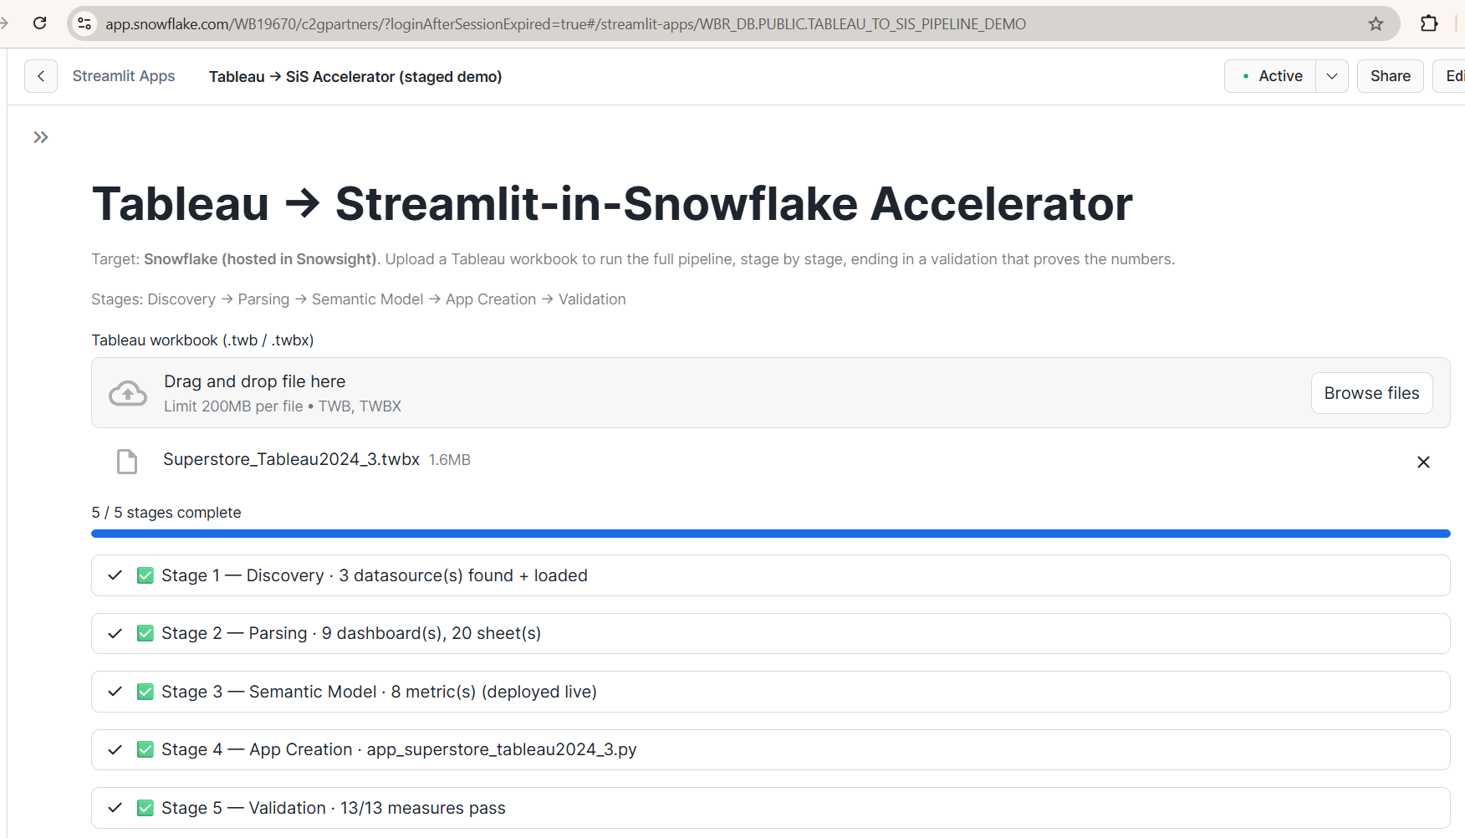
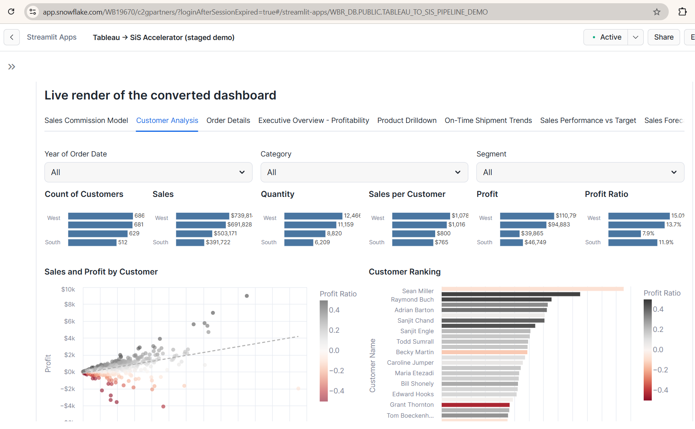
Running in Snowsight Today
One Tableau workbook, migrated end to end — hosted and executing inside Snowflake
The pipeline — five stages, executed in the account
The result — the converted dashboard, rendered natively
Superstore workbook · 3 datasources loaded · 20 sheets across 9 dashboards · 8 metrics deployed live · 13/13 measures pass.
Nine dashboard tabs with their filters, KPIs and charts — reading live from Snowflake tables.
Every statement is visible in Snowsight Query History with live timestamps.
Notes:
Real screenshots from the hosted app — the Snowsight URL and chrome are visible in both. Land on the left first: nine dashboards, twenty sheets, one run, thirteen of thirteen measures tying out. Offer to run it live; open Query History alongside if anyone questions where it is executing.

Slide 6
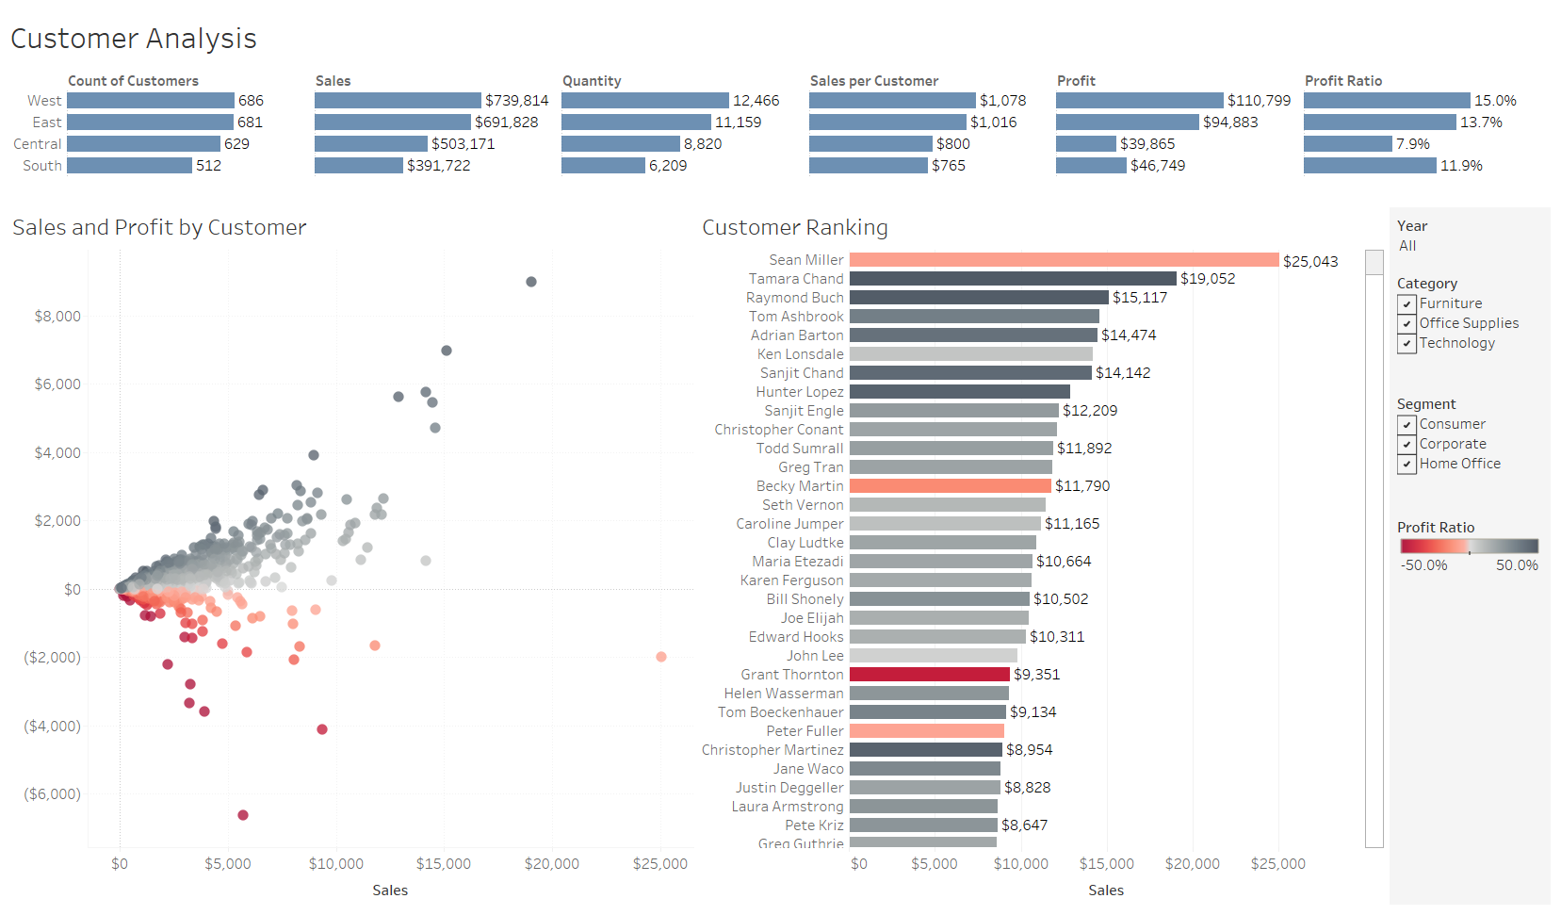
Tableau vs. Streamlit in Snowflake
The same dashboard, side by side
TABLEAU
STREAMLIT IN SNOWFLAKE
Same filters, same KPIs, same numbers — validated measure by measure at migration time.
Notes:
Mirrors the Tableau-vs-Power-BI comparison slide from the reference deck. Both sides show the SAME dashboard — Superstore Customer Analysis — and the numbers match cell for cell: West 686 customers, Sales $739,814, Sean Miller top-ranked at $25,043. Let the images do the talking; the one-line caption is the only claim on the slide.

